Slide 2

PROTOTYPING
From concept to reality: How prototyping shapes successful systems.
PRESENTED BY: GROUP A9

Slide 3
KEY PURPOSE
WHAT IS PROTOTYPING?
CLARIFY REQUIREMENTS
VISUALIZE THE SYSTEM EARLY
Definition: A methodology to create early, simplified versions of a system to explore ideas and gather feedback.
ITERATE BASED ON USER FEEDBACK

Slide 4
CHARACTERISTICS
ITERATIVE PROCESS
USER INVOLVEMENT
RAPID DEVELOPMENT
CORE FEATURES FOCUS
FLEXIBILITY

Slide 5
TYPES OF PROTOTYPING
1. THROWAWAY PROTYPING
Discarded after feedback
2. EVOLUTIONARY PROTOTYPING
Evolves into the final product
VS
3. HORIZONTAL PROTOTYPING
Focus on UI/UX
4. VERTICAL PROTOTYPING
Focus on specific functionality
VS
5. INCREMENTAL PROTOTYPING
Components built separately and integrated

Slide 6
STEPS IN PROTOTYPING
Repeat (Iterate)
Identify
Requirements
Develop the Prototype.
Evaluate the Prototype based on user feedback.
Refine the Prototype.
Develop the Final System

Slide 7
PROS AND CONS OF PROTOTYPING
Advantages
Disadvantages
Improved Requirement Understanding
Scope Creep
High Cost & Time Consumption
Early Error Detection
Miscommunication
Enhanced User Involvement
Poor Documentation
Faster Development
Not Suitable for Large Systems
Flexibility

Slide 8
REAL-WORLD Application
Best Application Environments suited for prototyping:
Project with Unclear Requirements
User-Centric Systems
Innovative and Experimental Systems
Short-Lifecycle Applications
Small to Medium-Scale Projects

Slide 9
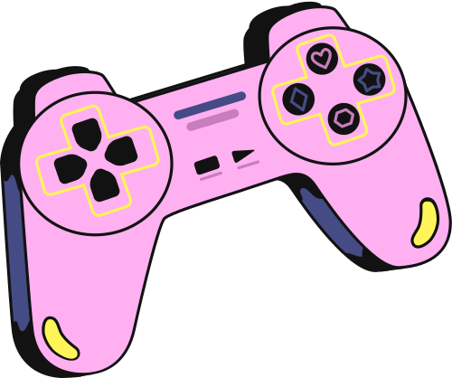
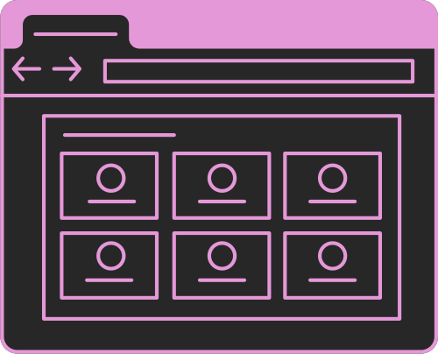

Examples of such Applications
E-Commerce Website
Gaming Industry
Healthcare System
Game mechanics and gameplay testing
Testing UI/UX for online stores
Patient management system refinement

Slide 10
PROTOTYPING TOOLS
Wireframing tools: Figma, Sketch, Adobe XD.
Development Frameworks: Bootstrap, React.
Mockup Tools: InVision, Basalmiq.
RAD Tools: OutSystems, Mendix.

Slide 11
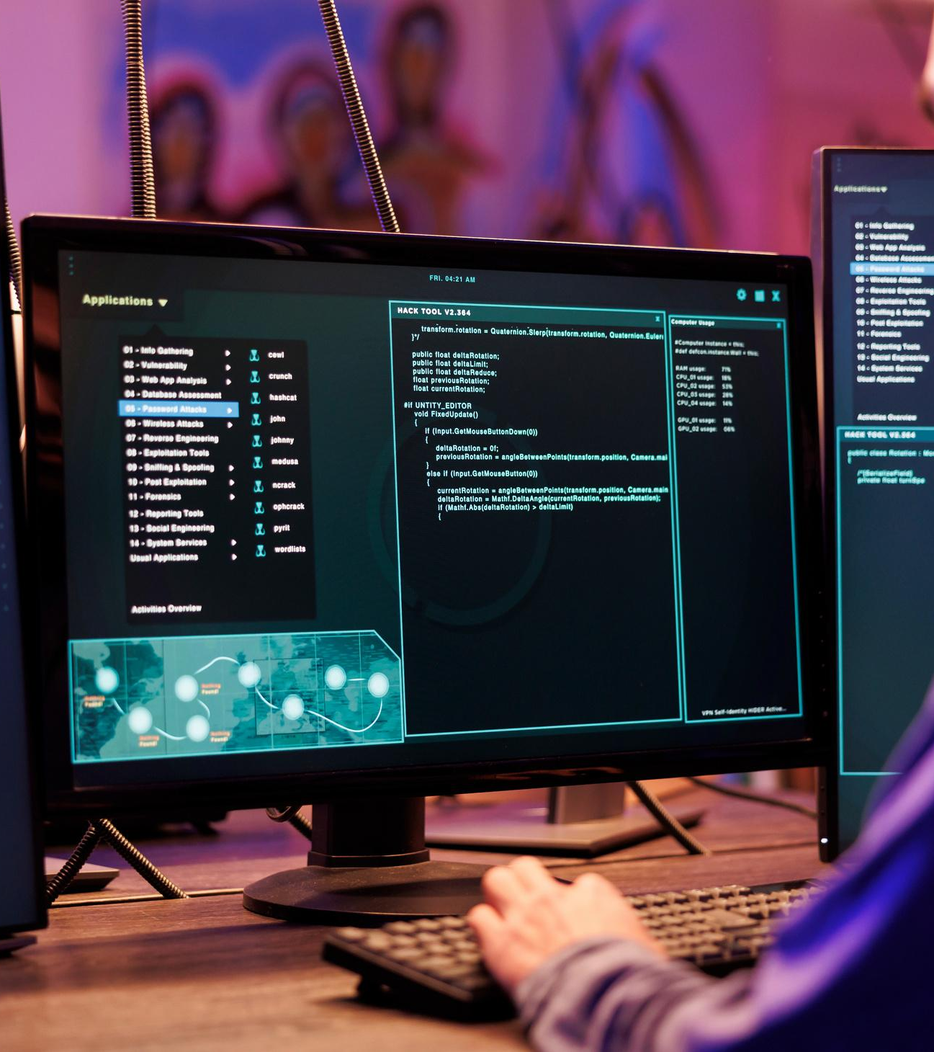
CONCLUSION
User-centric and iterative.
Risk reduction and faster delivery.
Essential for modern system development.

Slide 12
THANK YOU

